Slide 1
MergedBrooklynDashboard - users
File created on: 5/7/2019 1:58:02 PM

Slide 2
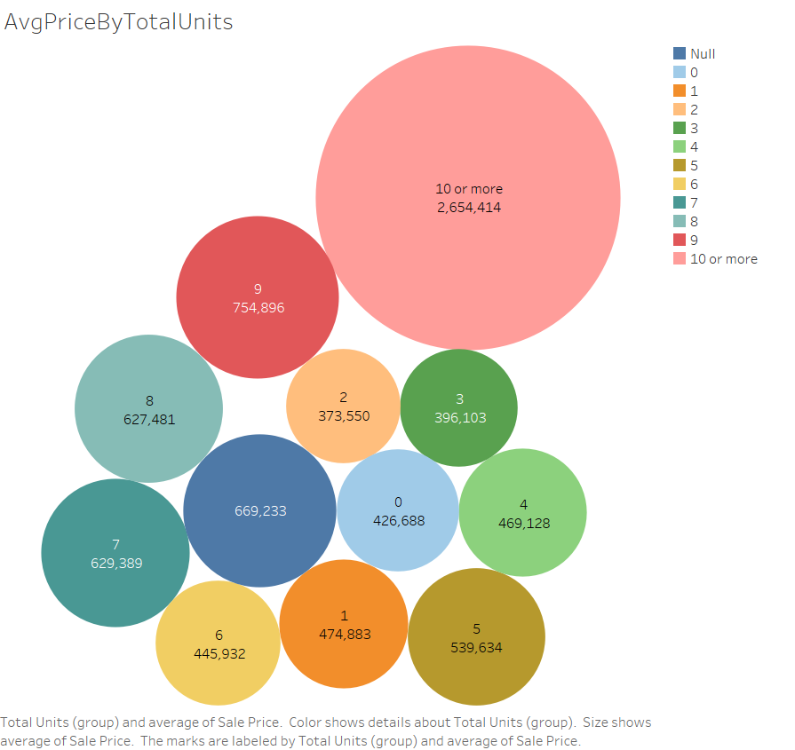

Slide 3
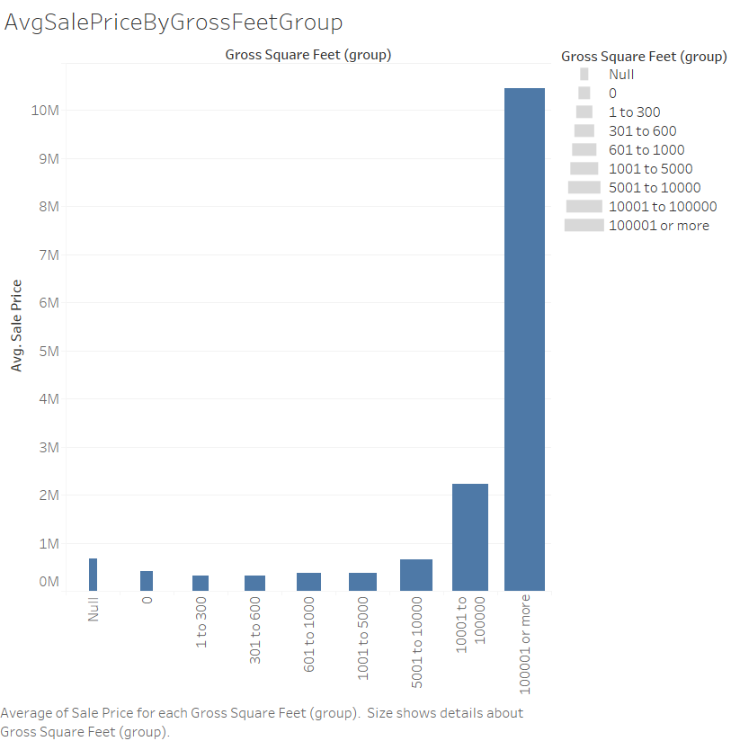

Slide 4
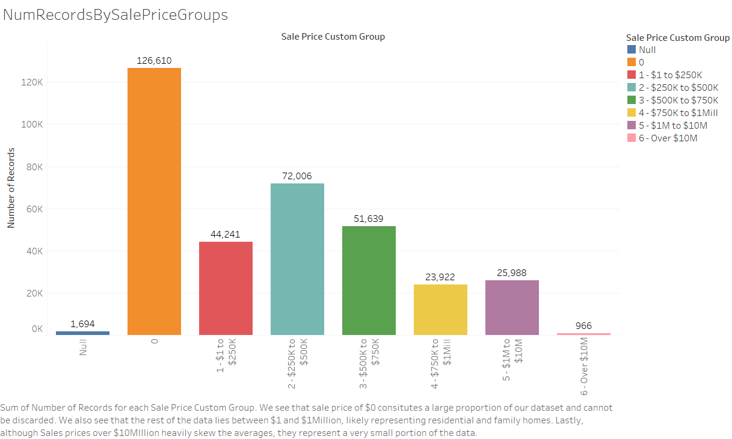

Slide 5
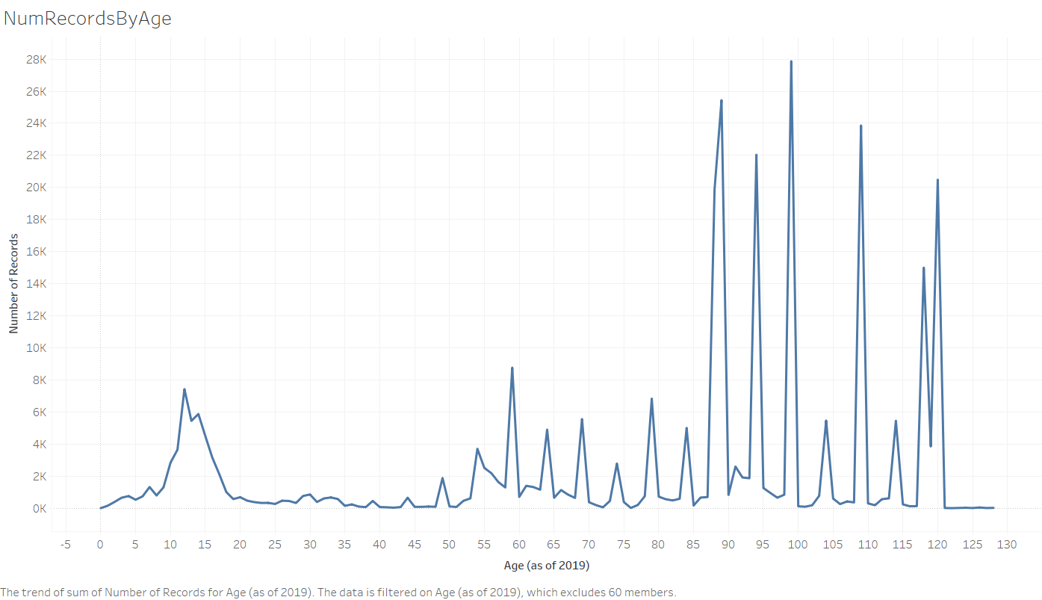

Slide 6
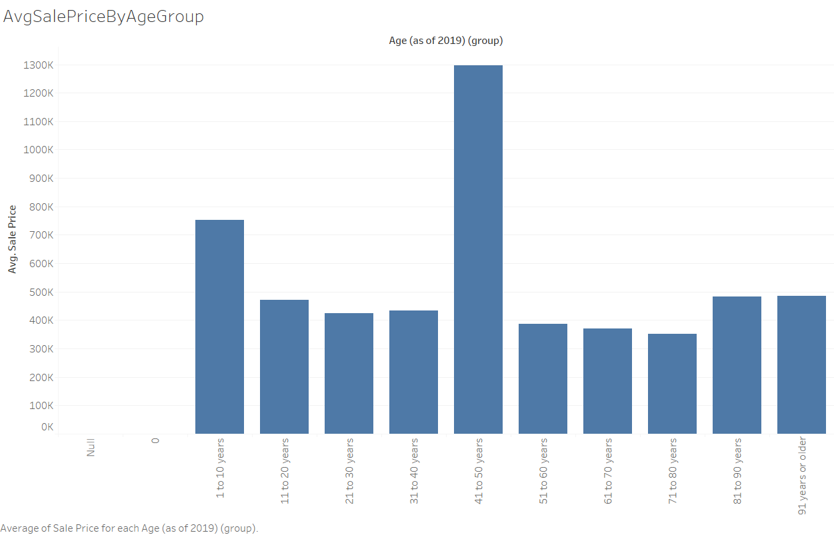

Slide 7
